Slide 1
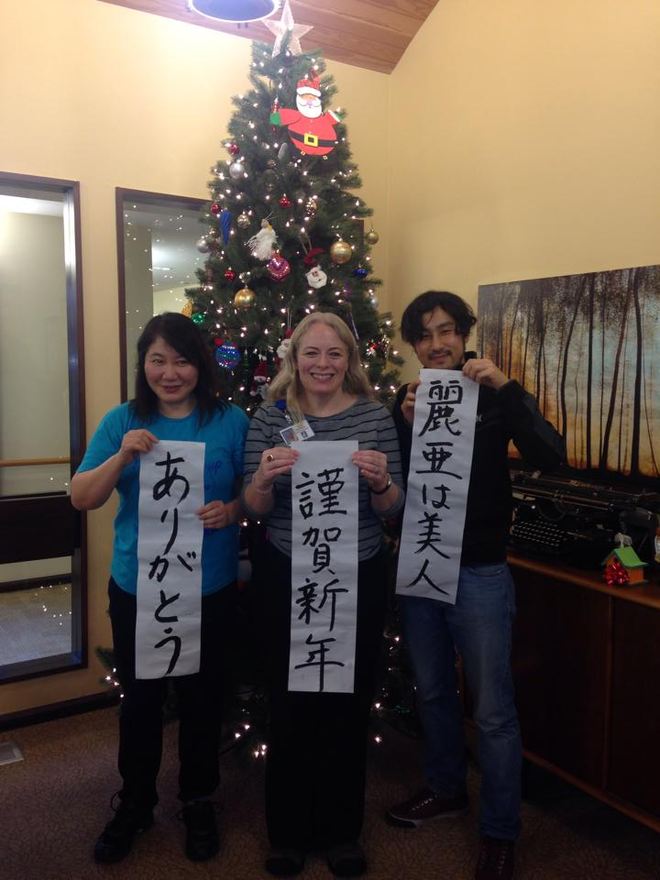
A New Book Plan “The World Caregiving” and Introduction of Japan’s Caregiving Issues
世界の介護と
日本の介護事情について
Photo : Junko, Leia, Masaki at memory care home
in Beaverton, 2014.12
ポートランドコミュニティカレッジ
老年学
尾渡 順子
藤本大規
Original presentation made by Junko Owatari
Edited by Masaki Fujimoto

Slide 2
Introduction of Junko
The new book plan “The World Caregiving”
The issues about Japan’s long-term care insurance
The issues about Japanese caregivers
Questionnaire
議題：▶Junkoの紹介▶世界の介護という新しい本▶日本の介護保険制度について
▶日本の介護職員について▶質疑応答

Slide 3
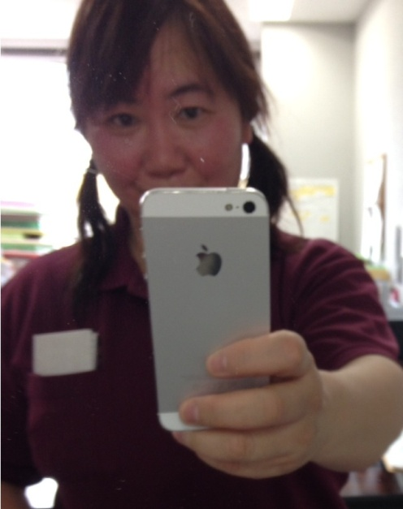
Introduction of Junko Owatari
She was here to study PCC Gerontology Program in Fall 2014
Now she’s taking classes online from Japan
Well-known as a master of caregiving and
an activity instructor in Japan
She has written some books about
caregiving and activities
Now she is planning to write about “The World Caregiving”
Junkoの紹介
▶彼女は2014年秋学期において、ここポートランドコミュニティカレッジの学生だった。
▶今でも日本からオンラインのクラスを取っている。
▶日本ではアクティビティ講師や介護福祉士の先生として知られている。
▶介護やレクリエーションについて何冊か本を書いている。
▶今、「世界の介護」について新しい本を書こうとしている。

Slide 4
Outline of “The World Caregiving”
Target Readers : Japanese caregivers
Collaboration with multiple writers. I’m in charge of US part.
Objective:
Know the difference and similarity between Japan and other countries
Share the problems and good practices
Will be published next year
Japan
Finland
▶読者の対象
日本の介護職
▶数名のコラボ
僕はアメリカ担当
▶日本と他国の相違点
、類似点を知る
▶問題や利点をシェアしよう
▶来年出版される・・かな？
USA
Germany
Korea
Indonesia

Slide 5
We use MANGA! -Japan’s most popular cultural export
その本は、漫画を使います！

Slide 6
We need help from Geronauts to collect the materials for the book!
老年学クラスの皆さん、本のネタが欲しいの！助けて～！

Slide 7
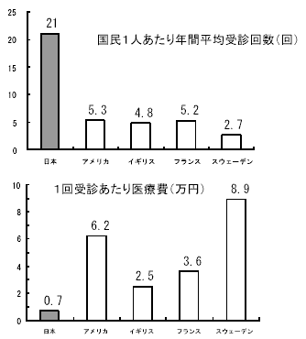
Long-term Care Insurance System in Japan
Reference: Tokyo Metropolitan Government
Everyone over 40 must pay for the insurance
Everyone over 65 are eligible for the benefit of the long-term care insurance
Long-term Care Insurance covers 90% of the care cost
Hospital visit is covered by National Health Insurance.
It covers 70% of medical cost.
Both National Health Insurance and Long-term Care Insurance are mandatory
Hospital visits / per person/ per year
40歳以上の全ての人が
保険に入らなければならない。
65歳以上の全ての人が
介護保険を利用する資格が
ある。
介護保険制度は90％が
保険料から支払われる。
受診料は国の医療保険より
70％が支払われる。
医療保険も介護保険も
強制保険である。
JP US UK France Sweden
JP US UK France Sweden
Pay per visit (x $100)

Slide 8
Good for elderly But… We have problems in this system
高齢者にはいいけれど・・・・。
でも、
介護保険制度にもたくさんの
問題点があります！

Slide 9
Rapid Population Aging
急激な高齢化
1/4 are over 65 in 2015

Slide 10
Japan has the greatest population aging in the World
日本は世界でも高齢化率はトップ１
Japan
Germany
Sweden
USA

Slide 11
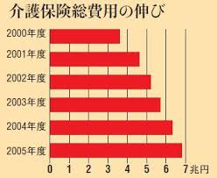
Care Insurance Cost Doubled only in 5 years
Fewer young generation must
support more elders’ life
OMG!!!!!
x $10 billion
たった5年間で介護保険料が2倍になってしまった！

Slide 12
How to apply for the Long-term Care Insurance System
介護保険の申し込み方
Visit the municipal office directly
* If the person is unable, representative can apply
Anyone over 65 (primary insured person) can receive all services
Those aged 40-64 (secondary insured person) are eligible for the benefits only when they come to need long-term care due to one of 17 specified disease
ex) Terminal cancer, Parkinson’s disease,
Early onset dementia, Osteoporosis, etc.
市役所を訪ねてください。本人でなくても代理の方でも構いません。
65歳以上（第一号被保険者）は全てのサービスが受けられます。
40から64歳の方は17の特定疾病であれば受ける資格があります。

Slide 13
Levels of the certified care and services available
more serious
認定される要介護度のレベル

Slide 14
Certification Process
認定のプロセス
Investigation
by the home visit
(by municipal officer)
訪問調査
Drawing up a care plan
ケアプラン作成
1st Judgment
by computer
コンピューターのよる
一次判定
2nd Judgment
by conference
カンファレンスによる
二次判定
the service is available
サービス利用開始へ

Slide 15
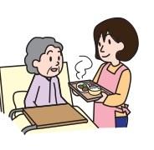
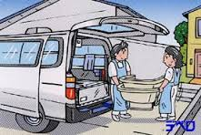
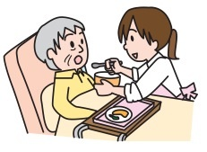
Home Care Services
訪問介護サービス
Home help services
夜間対応型訪問介護サービス
Home help services at night (Regular visits & on-call visits)
訪問入浴サービス
Home-visit bathing services
訪問看護サービス
Home-visit nursing (A nurse)
Home-visit rehabilitation (A PT, OT, ST and so on)
訪問リハビリ
Management guidance for in-home care(A doctor, dentist, pharmacist, nurse and so on) 居宅療養管理指導

Slide 16
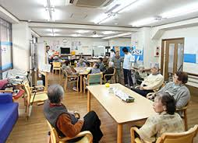
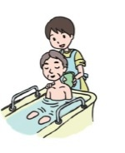
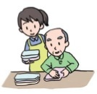
Respite Care Services
デイサービス
Day Services
認知症対応型デイサービス
Day services for elderly with dementia
デイケア
Day rehabilitation services (day care)
ショートステイ
Short-stay daily-life services (welfare-oriented short-stay)
Short-stay medical services

Slide 17
Small-scale and multifunctional in-home care
小規模多機能居宅介護
Conventional
Small-scale and multifunctional in-home care
Home
In-home service
Day service
Short stay
Combination of In-home and Respite care
昔の方式から新しい方式に。
This idea has started in 2006
The government encourage this service (to reduce gross insurance payment)
Goal: Accepting 0.4 million users by 2025 (7x as of 2011)
But
Not increasing as expected because of difficulty in management
このアイディアは2006にスタートしました。政府はこのサービスを一押ししています。
が、経営が難しく思ったほど増えていません。

Slide 18
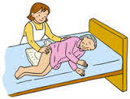
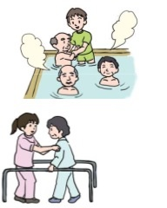
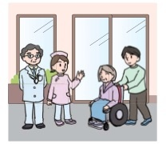
Facility Care
介護老人福祉施設（特別養護老人ホーム）
・Welfare facility for the elderly
requiring care
地域密着型特別養護老人ホーム
・Community-oriented welfare
facility for the elderly requiring care
介護老人保健施設（老健）
・Health service facility for the elderly requiring care(rehabilitation)
Like a “nursing home” in the US
Small branch of nursing home less than 29 residents
Not enough nursing homes.
Many elders are waiting for the vacancy
Notes:
Junko works for “nursing home” The monthly fee paid by residents is about $10,000. It’s reasonable. Most of the nursing homes are owned by non-profit.

Slide 19
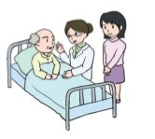
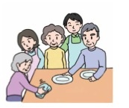
Facility Care
介護療養型医療施設
Sanatorium type medical care facility for the elderly requiring care
グループホーム
Daily-life group care for the elderly with dementia(group home for the elderly with dementia)
特定施設（有料老人ホーム）
Daily-life care service in specified facilities
Community-oriented daily-life care service in specified facilities
Like a “Memory Care” in the US
Only for rich people
Pay initially $10,000 – 100,000
and $3,000 – 4,000 monthly

Slide 20
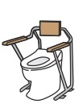
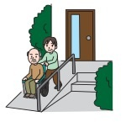
Other Services
福祉用具貸与
Rental of welfare equipment
福祉用具購入
Allowance for purchasing welfare equipment
住宅改修
Allowance for home renovation

Slide 21
Insurance covers 90% of care cost
保険が90％介護料をカバーしてくれます。
Daily necessities and food expenses are not covered
ホテルコストは除外
Monthly insurance premiums depend on one’s income
Average is 4,160 yen (approx. $34)
毎月の保険料は利用者の収入に応じて異なるが、平均としては4,160円。

Slide 22
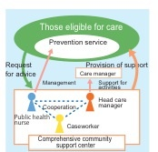
Community Support Service
地域包括支援センター
地域支援事業
Community Support Service
*Long-Term Care Prevention Services
*Care Prevention and Daily Life Support
Comprehensive Service
*Comprehensive Support Service
*Voluntary Service
コミュニティサポート
＊長期ケア予防
＊介護予防と日常生活支援
包括サービス
＊地域包括支援センター
＊ボランティアサービス
The government has focused on Preventive Healthcare
supported by community
政府は地域コミュニティによる
介護予防健康作りに焦点を当てたが
Because…
Most of the insurance is used by Mild care level (Support level to Care level 1)
They have tighten the insurance budget.
The government have decided to cut the benefit for mild care level
They hope to reduce the number of mild care level by community support
保険料の多くは要支援や要介護１などの介護度の低い人達が使っている。
政府は要支援を介護保険から外すことい決めた。
地域で要支援の人を支援していく方向にしたのだ。

Slide 23
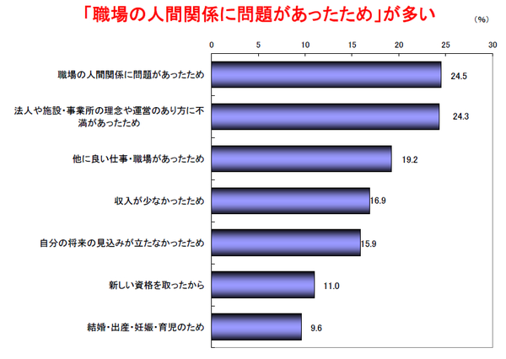
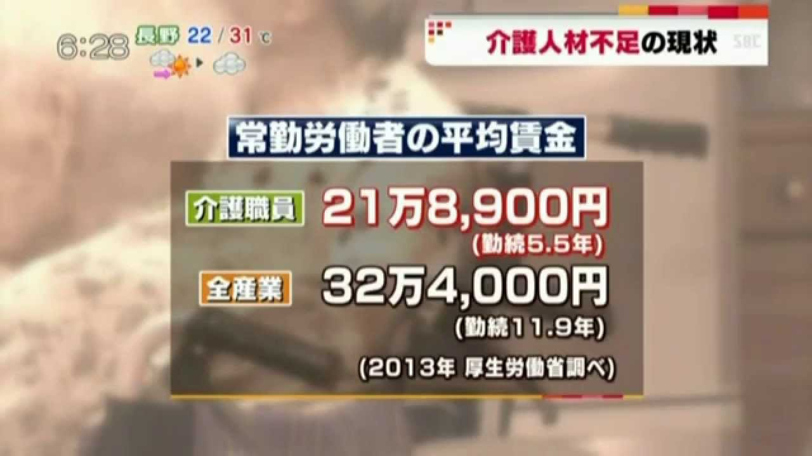
Poor Working Condition for Caregivers
劣悪な介護労働環境
Japan is facing massive Caregiver Shortage.
Will need 300,000 more caregivers by 2025 (now 1,770,000 caregivers in Japan)
日本は慢性的な介護職不足に悩まされている。
2025年には30万人の介護職が必要だと言われている。
Average Wage
Reason for leaving a job
problematic relationships
in the workplace
Disagreement with
boss, manager
Caregiver
To find a better job
All occupations
Low wage
Worry about future
Getting a new license
Though caregiver turnover is not so high as the US.
Marriage, pregnant

Slide 24
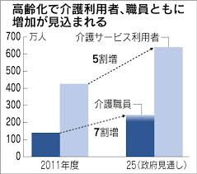
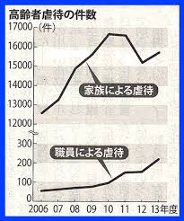
Our Task: Improve Quantity and Quality
我々の課題： 介護の質と量の向上
Elder Abuse Cases
高齢者虐待の件数
Million
people
Caretakers
50%UP
By Family
Caregivers
By Worker
70%UP
Prospect
Quantity
Quality

Slide 25
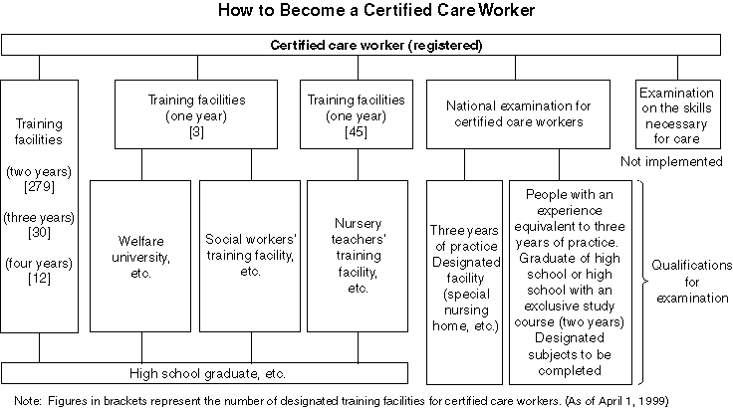
Not Easy to Be a Certified Care Worker
介護福祉士になる為には・・。 なかなか簡単にはいきません。
…But, not rewarded enough
でも給料は安いんです！！

Slide 26
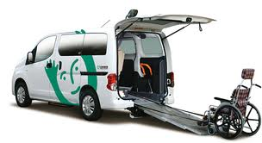
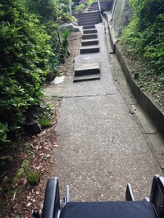
Junko’s one day in Adult Day Care Service
デイサービスでのJUNKOの1日
8 AM : Picking up the participants
Narrow Streets & Many Stairs
細い道路とたくさんの階段
Must push a wheelchair up-and-down-stairs
階段の上り下りを車いすを押しながら！！
Hard and dangerous especially in a rainy day
雨の日は特に、きつくて危険。
Notes:
Junko’s facility, the vehicle fit about 10 people. Carry 20 people using 3 vans and 1 small car. They have paid driver, but caregivers also need to go. To decide the route is one of the hardest task. Lots of things to consider. It’s caregiver’s task.

Slide 27
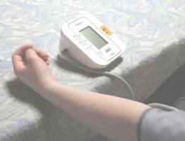
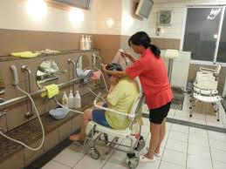
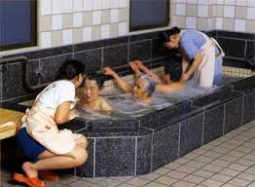
Bathing, the most important and hardest work
入浴、もっとも重要できつい仕事・・・・・。
Soaking in the bathtub is long-established custom in Japan. Most elders want to take a bath every day
9:15- Vital Check (body temp, BP, pulse) before bath
浴槽に体を浸かるのは、日本の伝統的な習慣である。殆どの高齢者は毎日風呂に入りたがる。
Caregiver stays in the bathroom for 3 hours to help 20 participants take a bath safely
2 caregivers in the bathroom, 1 for dressing aid, 1 for taking them to the bathroom, and 1 nurse
入浴介助の介護職員は午前中3時間風呂場にとどまり、20人の利用者を安全に入浴させます。
Effect of bathing（入浴の効能）
Relax, Improve blood circulation, Keep clean,
Rehabilitation (like a swimming pool)
Can find elder abuse or disease (ex: breast cancer)

Slide 28
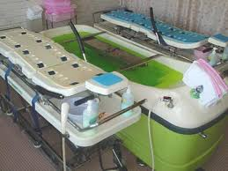
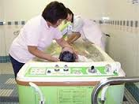
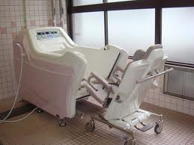
Bath Machines
特浴
Bath Machine with Stretchers (Price $88,000)
ストレッチャー付きのこの特浴は88,000ドルします。
Bath Machine for Wheelchair Users
enables to take a bath while sitting on the wheelchair
車いす使用の方向けの浴槽。車いすに座ったままお風呂に入れます。
Junko’s facility has 2 each

Slide 29
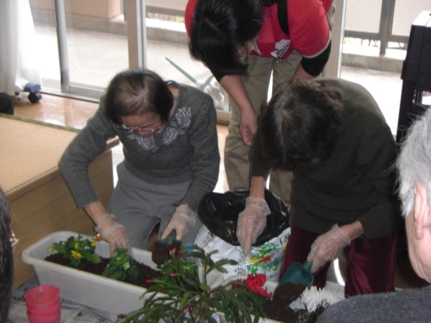
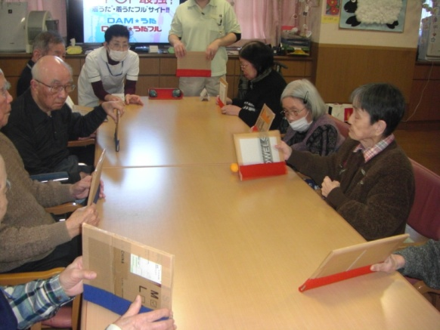
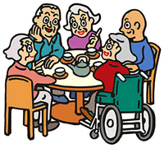
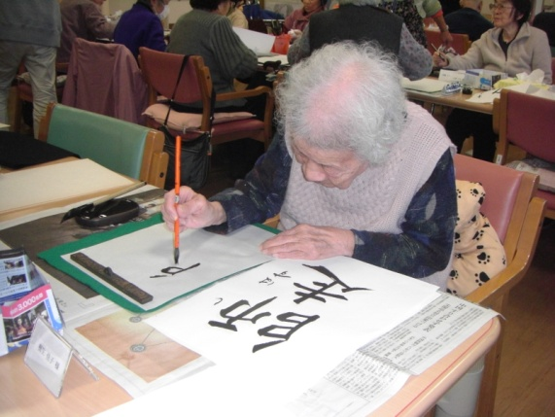
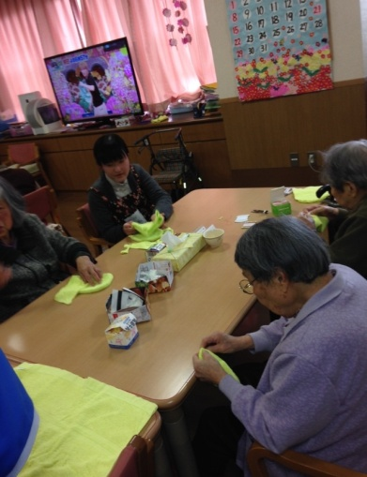
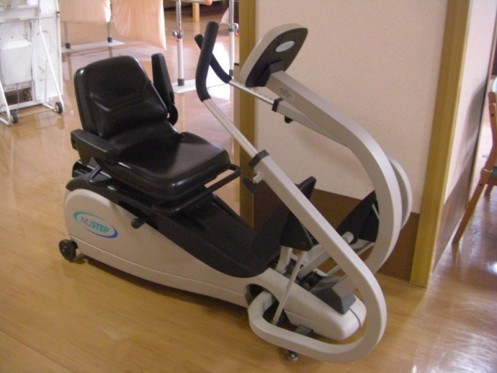
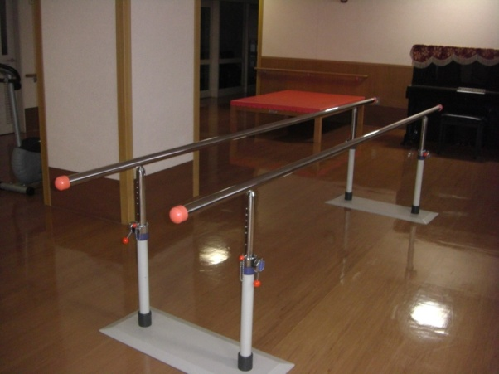
12:00 Supporting Lunch
12:00 食事介助
12:30 Supporting Toilet
1 – 2pm Take a Break
Participants are divided into several groups and enjoy activities like craft, sewing,
card game, physical exercise, horticulture, etc.
12:30 トイレ介助
1~2時（職員は交替で休憩）
利用者は幾つかのグループに分け、工作、
酒豪、縫い物、カードゲーム、体操、園芸
などのアクティビティをおこなう。

Slide 30
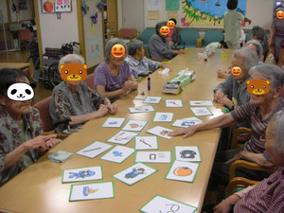
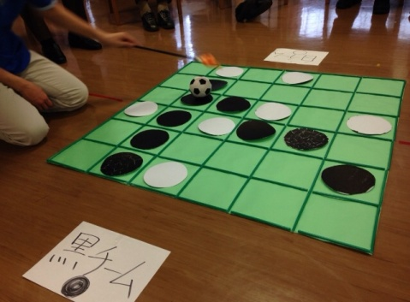
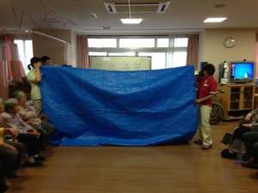
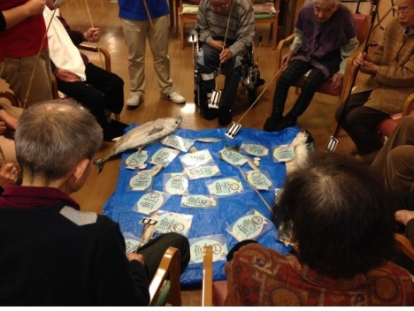
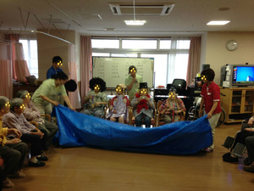
2:20 Activities : Exercise and Games
2:20アクティビティ。体操とゲーム
Spot the difference! game
3:20 Tea Time & Karaoke
3:20 お茶の時間と読書。
4:15 Take them back to their homes
4:15 家へ送っていく。
4:45- Paper Work
4:45 事務仕事
5:30 Finish!
5:30 終了！
But… we usually have
Unpaid overtime work
サービス残業！！！！
Notes:
Overtime work includes paper work. Like, if residents attend the activity or not, take a bath or not… If the record is not accurate, the facility cannot get the money from the long-term care insurance system.
Making a route map for picking up participants is really hard task. Usually head of caregiver is in charge of it. Usually work overtime to make plan for tomorrow.
To take notes about participants to share the information with other staff. Ex) Do not wash her hair because she injured her head.

Slide 31
I Love My Job
私はこの仕事が大好き！
There are a lot of things to learn from my job.
Every day is challenging and makes me grow up.
Junko
この仕事から学ぶべきことは多く、
毎日がチャレンジの連続、私を成長させてくれる。
Junko

Slide 32
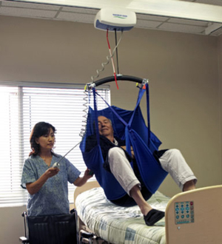
Differences between Japan and US
No Activity Director Position in Japan
Majority of caregivers is minority or immigrants in the US
Strong religious influence in the US
Bathing is the hardest work in Japan
Japanese caregivers work overtime even though unpaid
Use lift equipment to carry residents in the US
Care Insurance covers 90% in Japan
The US has the system to pay for family caregivers
日本とアメリカの違い（介護職として）
▶日本にはアクティビティディレクターの職種がない
▶大多数の介護職はアメリカではマイノリティか移民
▶宗教の影響が濃い
▶入浴介助が一番きつい
▶日本の介護職はサービス残業をする
▶アメリカではリフトを使っている
▶日本では介護保険が9割カバーしてくれる
▶アメリカでは家族介護者に給料が支払われるシステムがある。

Slide 33
3 Hardest Tasks for Japanese Caregivers
By Junko
No.1 Bathing Aid (Especially in Summer)
No.2 Changing Diapers
No.3 Picking up the Participants
Junkoによる、日本の介護職の３大きつい仕事
▶真夏の入浴介助
▶おむつ交換
▶送迎
Notes:
When Junko worked at rehab center, she changed 7 diapers in the afternoon and 30 at night. This task hurt her chest. Bathing use chest, too.

Slide 34
3 Typical Complaints of Japanese Caregivers
Manager always says “Improve utilization rate”
We always think, “Do it yourself!”
Whenever something happens, we have to write Incident Report.
“Oh my god… I must work overtime again to finish the report.”
Why my salary is so low?
We need more staff!
By Junko
Junkoによる日本の介護職の３つの不満
▶上司は「稼働率を上げろ！」っていうけれど、じゃああんたがやれ！って思う
▶何かあるとすぐ「状況報告」（この時間でもっと他にいい仕事ができるのに）
▶日誌を書くのはいつも残業・・・・。（サービス残業）
▶なんでこんなに給料が少ないの？
もっと職員を増やして！！！
Notes:
I wrote incident reports like really tiny bruise. Almost fell, but didn’t, and softly landed the knee on the floor. Somebody left the hair pin, but didn’t know whose. After the bath, mistakenly took other’s socks on.
Accidently caregivers finds an incident, someone has to write a report. No one want to. Often shifting blame on shoulders each other. That is one of the causes of making workers’ relationship worse.

Slide 35
3 Good Things of Japan’s Caregiving
Long-term care insurance benefits all elders
We don’t have a Labor Union. But, caregivers voluntarily build relationships to share the information and study each other.
It’s not limited to Japan, but we can learn a lot from elders.
To live, to die, and what is important in our life…
By Junko
日本の介護の３つのいいところ
▶介護保険は全ての高齢者に適用されること
▶我々は労働組合を持っていないけれど、外部の集まり
（笑福会のような）があり互いに成長できる。
▶日本に限ったことではないけれど、
高齢者からいろいろな事を学べる。
生きること、死ぬこと、人生において何が大切か・・・。

Slide 36
We’d like to know…
Simply feedback of this presentation（感想）
What is the hardest task for caregivers in the US?（きつい仕事）
What is the typical complaint of caregivers in the US?（不平、不満）
What is the good things of caregiving in the US?（いいこと）
What is the problems of caregiving in the US?（問題点）
Are you satisfied with your salary?（給料に満足している？）
Are you evaluated properly?（妥当に評価されている？）
Are you enjoying your job?（仕事が楽しい？）
I like this…（これが好き）
I hate this…（これが嫌い）
How high is the caregiver turnover in the US?（転倒は多い？）
If the turnover is high, Why?（何故？）
Is the long-term care insurance system like in Japan feasible in the US?
（日本の介護保険制度はアメリカで定着する？）

